Slide 1
CPSC131
Numerical Methods with MATLAB
Instructor : Thamira Hindo, PhD
Graduated in May 2014, Electrical and Computer Engineering, Michigan State University
Upon successful completion of the course, the student should to able to:
1. decompose a problem and identify an appropriate solution.
2. identify appropriate MATLAB or EXCEL tools and demonstrate an ability to apply these tools to a given problem.
3. apply numerical methods in order to solve problems in engineering and science.
4. Build a MATLAB GUI.

Slide 2
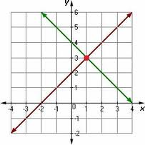
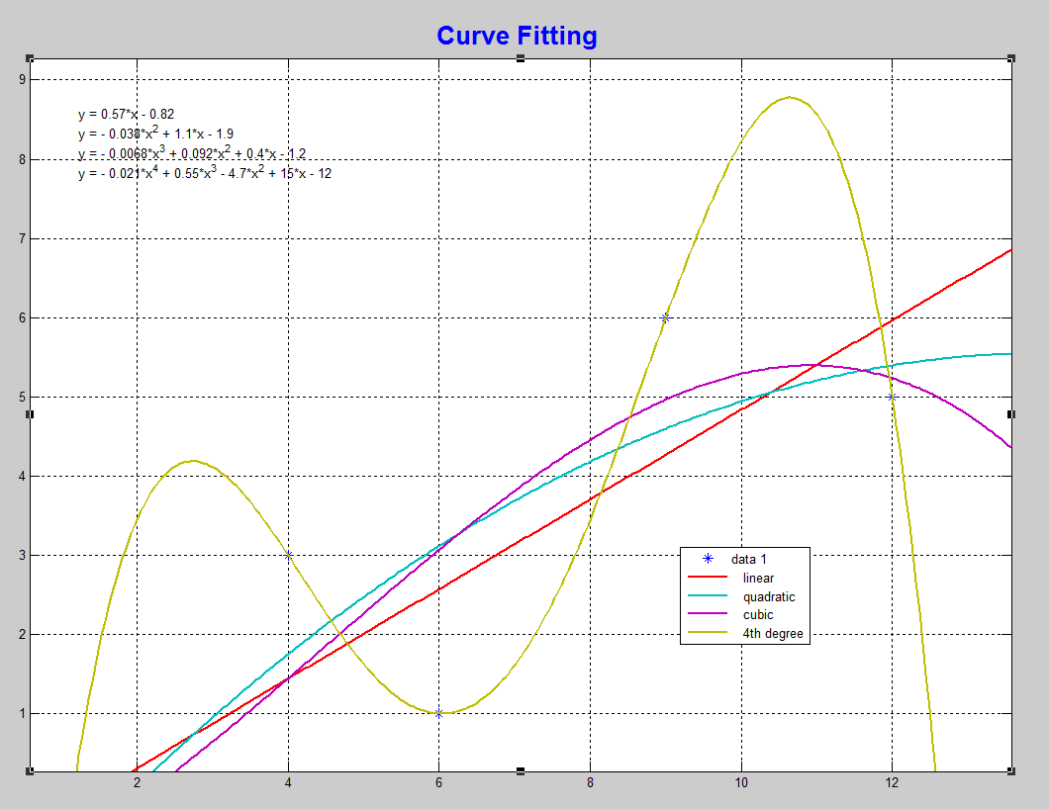
Computational Thinking
Means find the ways of solving problems and designing systems
means thinking algorithmically and with the ability to apply mathematical concepts
To understand Computations, numerical methods are used to:
solve problems using Gaussian elimination
find mathematical function using curve fitting

Slide 3
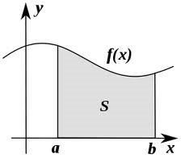
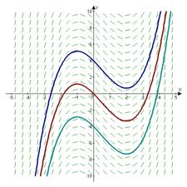
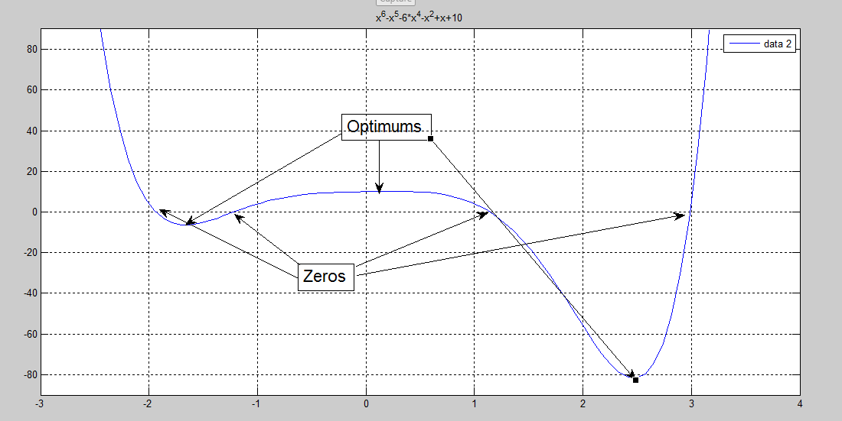
Numerical Methods
approximate the area under the graph of a function
Trapezoidal and Simpson’s Rules
approximate the solution of a first-order differential using Euler’s Method
estimate roots of a function using Newton’s Method

Slide 4
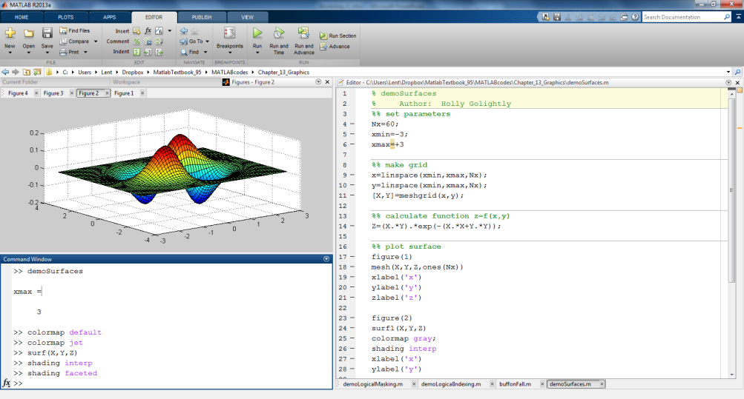
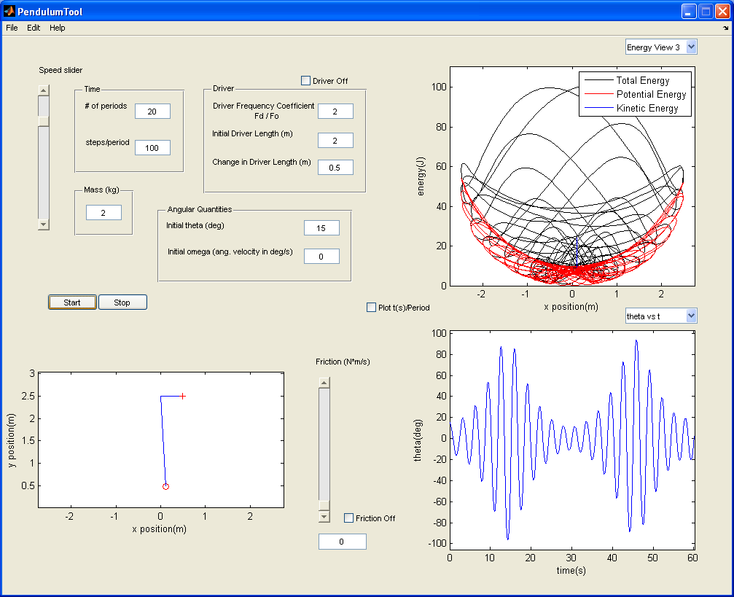
About MATLAB
Programming language for math, science, and engineering
Origin: Matrix Laboratory (Cleve Moler & Jack Little)
Rapid development of software tools
Many built-in math, science, engineering functions
Built-in graphics and graphical user interface (GUI) design
MATLAB GUI Tools Workshop

Slide 5
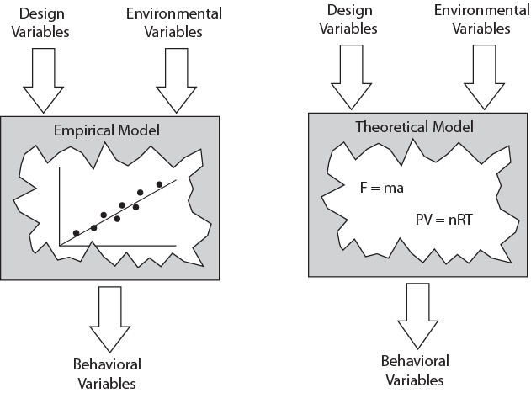
Engineering Models
Model: approximation to real world system
experimentation and data analysis
“laws of nature”
MATLAB GUI Tools Workshop

Slide 6
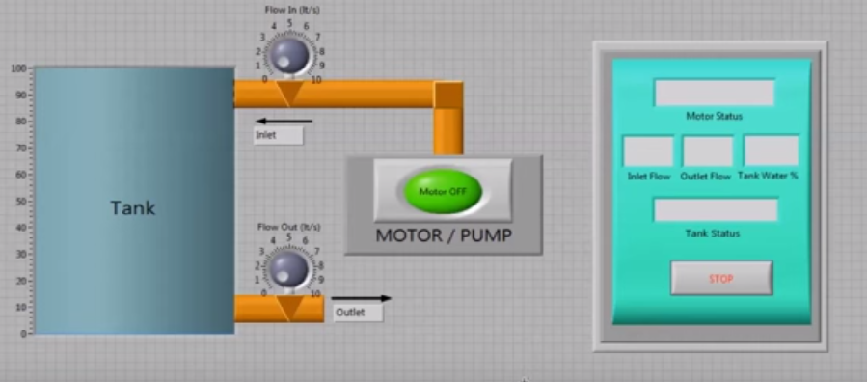
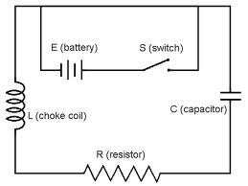
Dynamic and Control system for level
Input design variable: flow rate
The environmental variables are the pump and valves condition
Control system theory in adjusting level or flow.
Behavioral variables are : level
Input design variable is the input Voltage. The environmental variables are the resistance , capacitance, power supply and inductor using electrical fundamental theories. Then the output variable is the current
Electrical system

Slide 7
Basic EXCEL :
- Spreadsheet is a grid designed to hold values
- it can repeatedly perform the same calculation
- produce graph/ charts
- perform parametric analyses
Used in:
Business: time value of money, pie/bar charts, finance,
many built-in functions.
Statistics: Data analysis, regression, curve fitting, many
built in function.
Engineering: function graphs, not as many built in function.
Terminology:
Worksheet: one page of a spreadsheet document, tabs at
bottom indicate name.
Cell: one block within the worksheet identified by column
letter (A-Ivtotal of 256) and row number (1-65536)
Range : set of cells referenced from left /upper cells to right / lower cell.
Formula: any equation perform operation(mathematical or comparative )
Function : many built in functions known as functions to perform
simple or complex calculation.

Slide 8
Arithmetic Operations:
To enter a formula into a cell you start with an =sign in a cell or the function field.
Built in Functions:
Functions are used to perform dimple or complex calculations. EXCEL HELP is useful. Ex: SUM, AVERAGE, SQRT, ABS, ACOS,ASIN,ATAN,CEILING, COS, RADIAN….ETC
Absolute vs relative addressing:
Absolute cell referncing is used to keep a cell reference constant when copying use $ before column letter and row number: Ex. $c$3 is absolute, C3 is relative
You may use mixed references: C$3 will not change the row reference when copied, $C3 will not change the column
Goal seek:
Used to solve algebraic equation. If you know the result you want a formula to produce, you can use goal seek to determine the value of a cell on which the formula depends. It can back calculate through multiple formula in a sheet . It is found under Data Tab>What –if Analysis>goal seek.

Slide 9
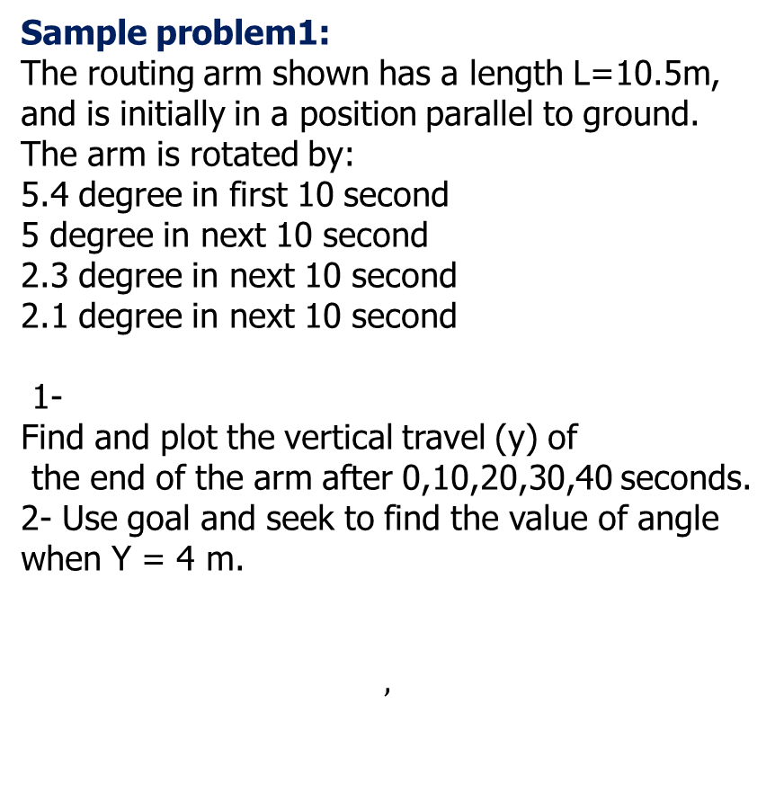
L=10.5
Sample problem1:
The routing arm shown has a length L=10.5m,
and is initially in a position parallel to ground.
The arm is rotated by:
5.4 degree in first 10 second
5 degree in next 10 second
2.3 degree in next 10 second
2.1 degree in next 10 second
1-
Find and plot the vertical travel (y) of
the end of the arm after 0,10,20,30,40 seconds.
2- Use goal and seek to find the value of angle when Y = 4 m.
$$,$$
y
ᶿ

Slide 10
 | Time | Rotation | Rotation | Height
 | sec | degree | radian | m
 | 0 | 0 | 0 | 0
 | 10 | 5.4 | 0.094248 | 0.988137
 | 20 | 10.4 | 0.181514 | 1.895451
 | 30 | 12.7 | 0.221657 | 2.308385
 | 40 | 14.8 | 0.258309 | 2.68218
Using goal and seek :
If y=4 then rotation = 22.392
Do your assignment and drop your EXCEL file in drop box

